Slide 1
Video Games
Do Video Games Bring Violence? A Technical Report of Evidence and Myth
A Short Discussion
Presented by
Isaiah Hoffer, UCCS Freshmen
University of Colorado, Colorado Springs

Slide 2

The Concern With Video Games
The rise of video games in the 21st century, has sparked a growing concern among the public. The public fears that there is a link between aggression and video games and has voiced this fear so extensively that some researches have begun to try to prove or disprove that video games cause violence.
One such study [1], was researching reasons why nations homicides and suicides differ between each other. The study proposed three different theories “economy, presence of guns and even exposure to violence in video games”, showing how significant this concern for violent video game is [1].
Video games' legal rating under U.S. laws shows content and age recommendation.

Slide 3
Difference Between Aggression and Violence
Most studies investigating video game and aggression only record short-term aggression, with the signs being a change in behavior or language. However, this way of testing is inconclusive. The changes in behavior are only temporary and disappear shorty after meaning this aggression has no correlation towards violence.
Study [2] decided to study long-term behavior and concluded that aggression was still proven to be found weeks after. However, the effect size was 1% meaning video games only caused 1% of the recorded aggression. This suggests that other factors have a much bigger impact than video games.
Chart shows causes of Long-term aggression

Slide 4
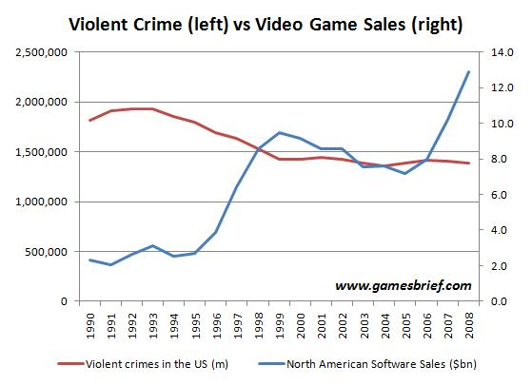
Video Games Stop Violent Crimes
If video games do cause violence than violent crime should be on the rise with video games. However, Study [3], found the opposite. Study [3] found, “crime data compared to video game sales, implying higher video game play rates, shows a decrease in property and violent crime in areas where violent video game play is increased” [3].
Chart from Gamesbreif. Shows rates for video game sales v. crime rates

Slide 5
Legal Rulings and Conclusion
From a legal standpoint, video games are seen as expressive media and thus are protected under the first amendment as shown in the Brown v. EMA (2011). “The case details reflect the inextricability of materiality and experience in considering video games as a form of expression”[4].
From these three areas: legal, psychological, and statistical, this report can only come to one conclusion: video games do not cause violence. While slight aggression has been observed; consistency and magnitude cannot justify the assumption. Other factors play a far bigger role than video games.
UCCS Hoffer

Slide 6
References
[1] Ferguson, C. J., & Smith, S. (2021). Examining homicides and suicides cross‐nationally: Economic factors, guns, and video games. International Journal of Psychology, 56(5), 812-823. https://doi.org/10.1002/ijop.12760
[2] Prescott, A. T., Sargent, J. D., & Hull, J. G. (2018). Meta-analysis of the relationship between violent video game play and physical aggression over time. Proceedings of the National Academy of Sciences - PNAS, 115(40), 9882-9888. https://doi.org/10.1073/pnas.1611617114
[3] Batty, S. (2021). A positive side of violent video game play. University of Saskatchewan Undergraduate Research Journal, 7(1) https://doi.org/10.32396/usurj.v7i1.473
[4] Hakimi, J. (2020). “Why are video games so special?”: The Supreme Court and the case against medium specificity. Games and Culture, 15(8), 923-942. https://doi.org/10.1177/1555412019857982

